Slide 1
Customer Service Center
The app will help Customer Service centers :
1. Automated Watson powered replies to customer queries.
2. Record Customer feedback or complaints.
3. Understand the recorded message by performing text analysis.
4. Analyze tone of the recorded message.
5. Store Cognitive attributes in dashDB for churn prediction for the next phase of the analysis.

Slide 2





Demo Solution architecture
Alchemy API
performs the language analysis
Conversation
( Facebook Messenger)
Tone Analyzer
(detect tone types and score)
Speech to Text
DashDB
stores the data persistently

Slide 3
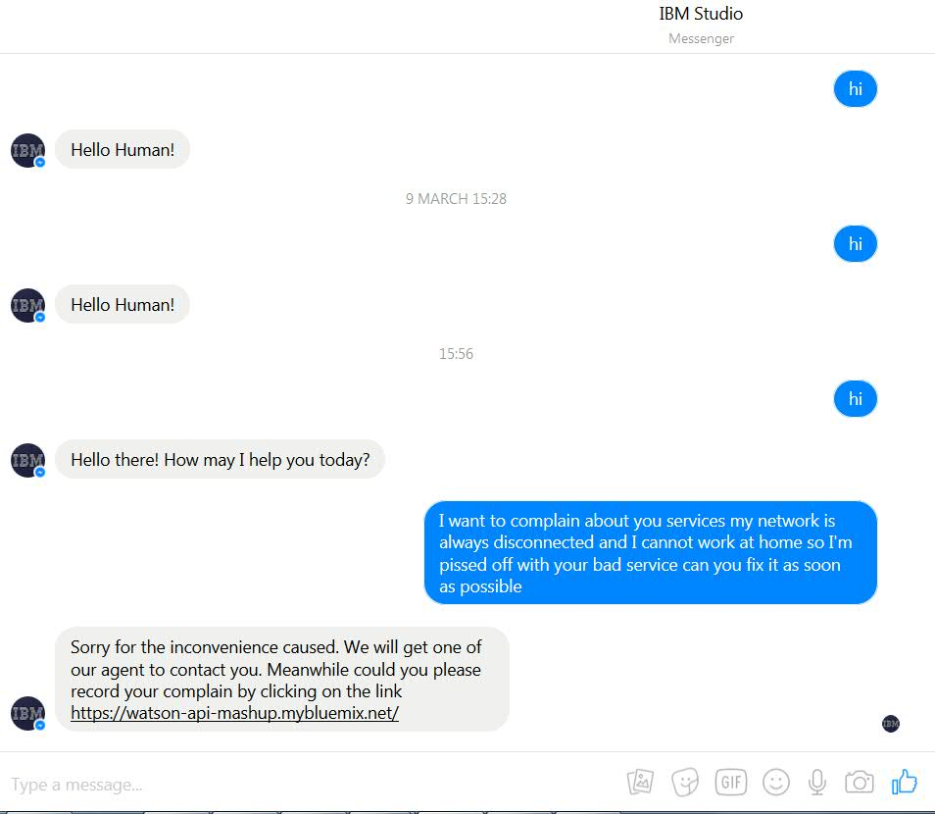
Facebook Messenger
This Chabot is integrated with company’s public Facebook page. It is powered by Watson Conversation API and responds to customer queries.

Slide 4
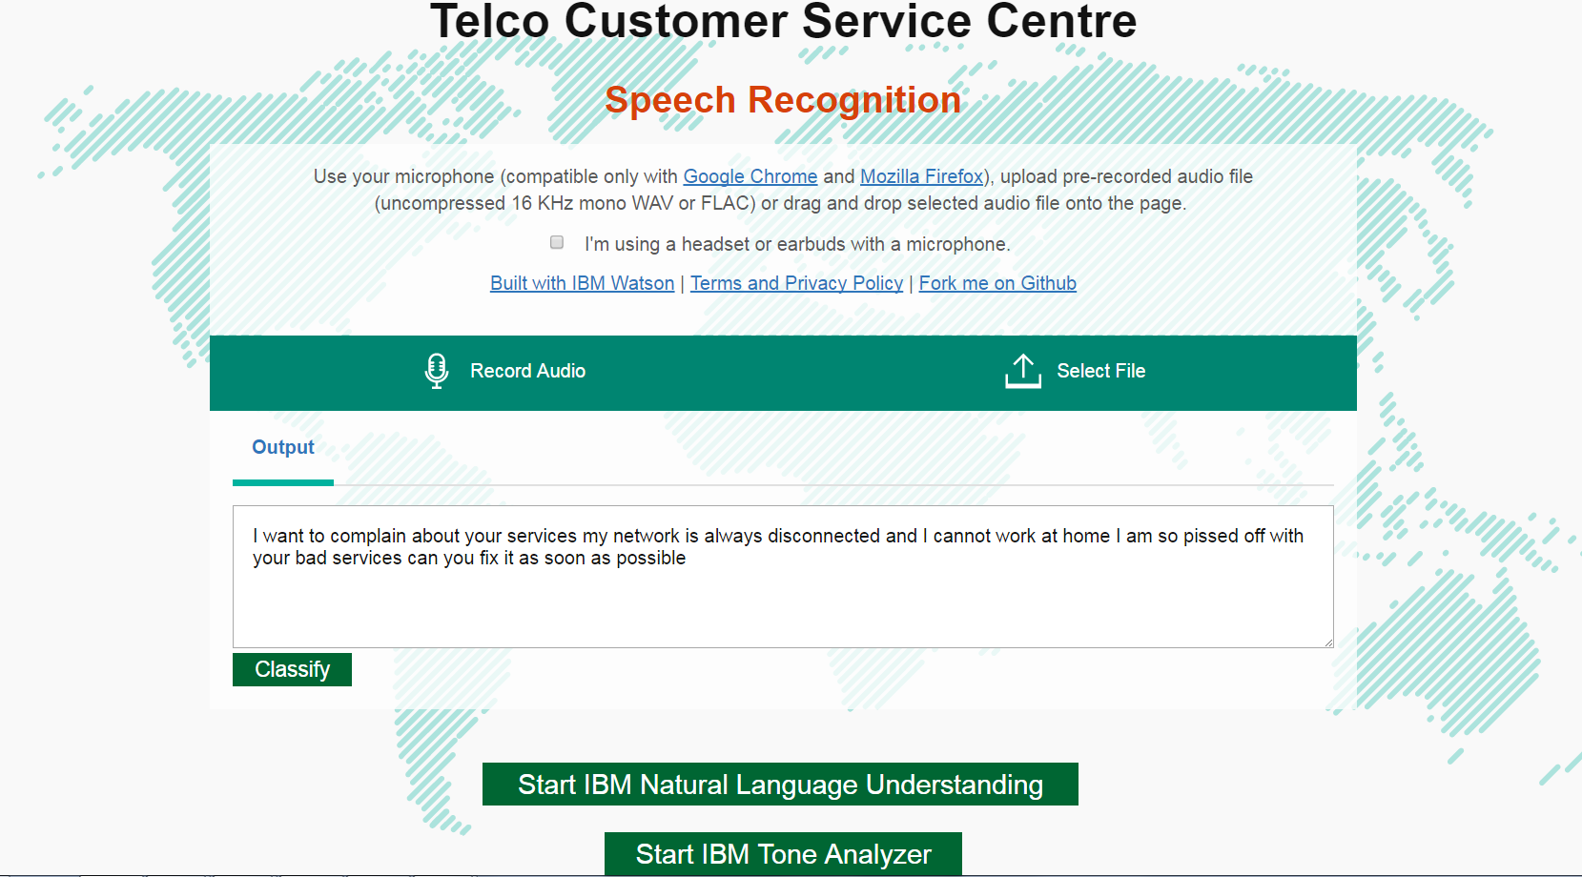
Speech To Text
This records customer feedback or complaints by using Speech To Text service.

Slide 5
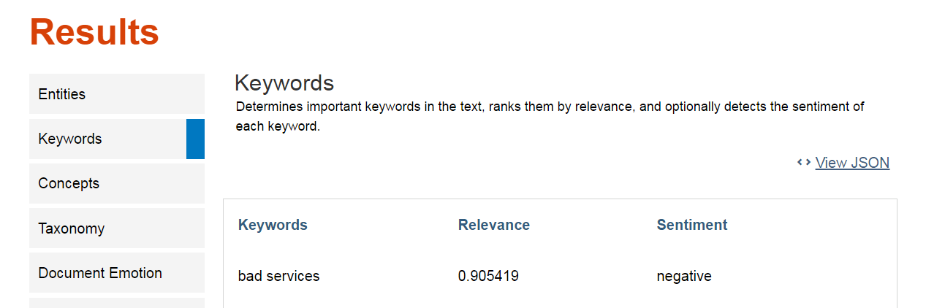
AlchemyLanguage
AlchemyLanguage is a collection of APIs which extracts different information such as keywords and sentiments through natural language processing.

Slide 6
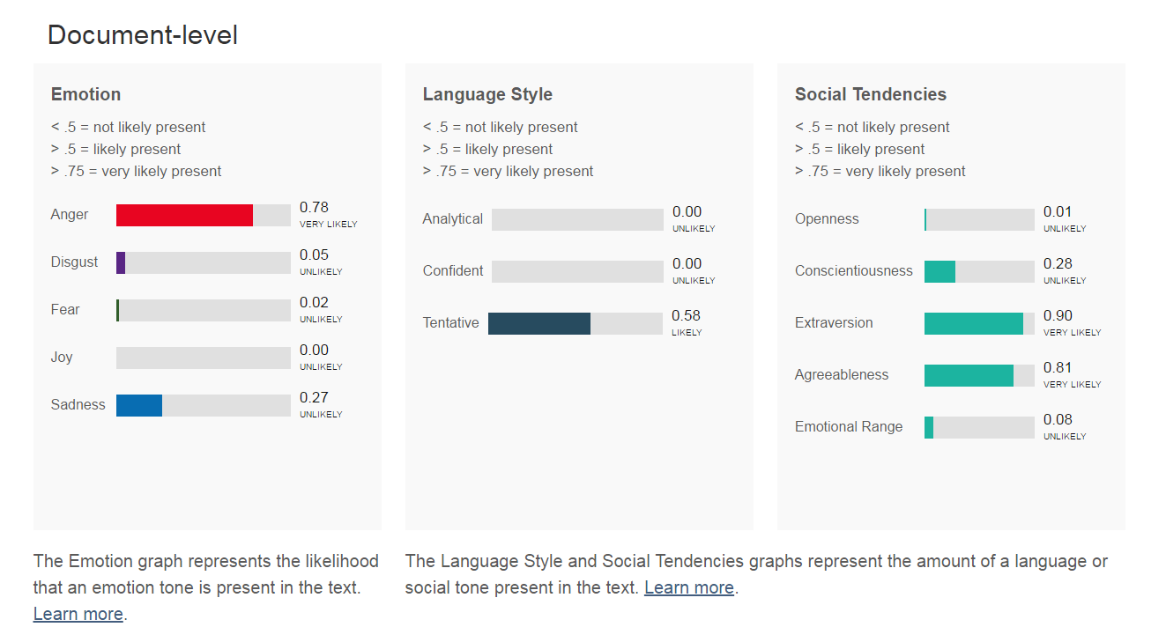
Tone Analyzer
Tone Analyzer leverages cognitive linguistic analysis to identify a variety of tones at both the sentence and document level. This insight can then used to refine and improve communications.

Slide 7
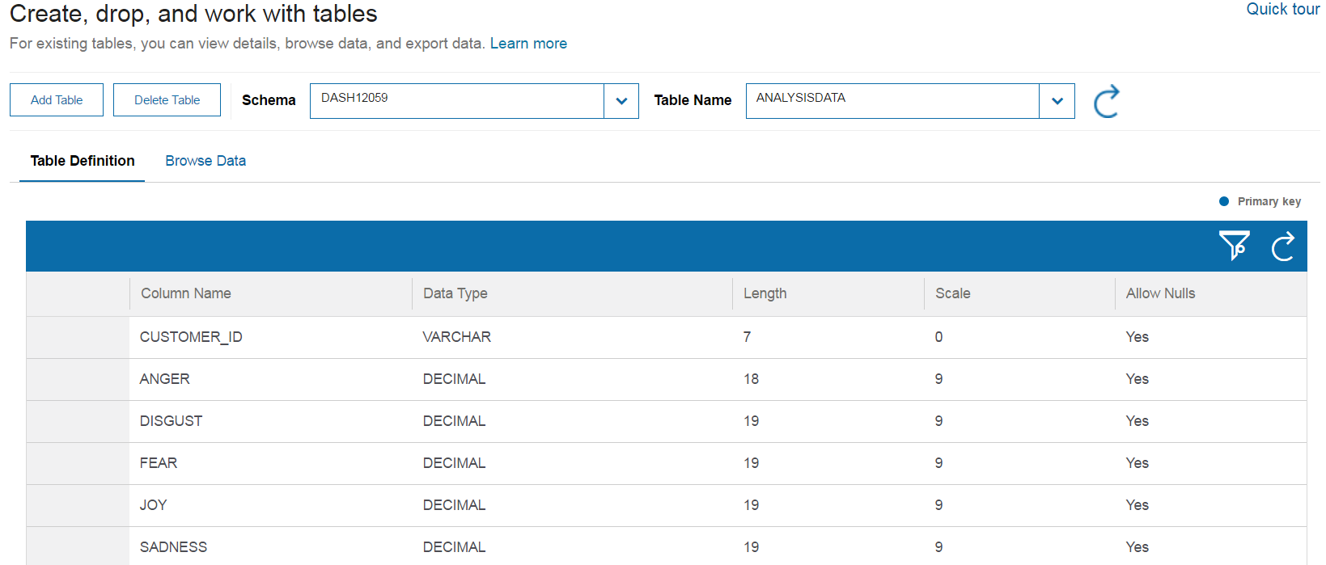
dashDB
New Cognitive attributes can be stored in dashDB, together with customer demographic information for further customer churn analysis.

